Slide 1
Algorithms: Design
Brute Force Techniques in Sorting and Searching
C. Oswald
VIT Chennai
Some contents are taken from CLRS, “Analysis of Algorithms” by Anany Levitin

Slide 3
Brute Force
A straightforward approach, usually based directly on the problem’s statement and definitions of the concepts involved
Examples:
Computing a^{n} (a > 0, n a nonnegative integer)
Computing n!
Multiplying two matrices
Searching for a key of a given value in a list

Slide 4
Brute-Force Polynomial Evaluation
Problem: Find the value of polynomial
p(x) = a_{n}x^{n} + a_{n-1}x^{n-1} +… + a₁x¹ + a₀
at a point x = x₀
Brute-force algorithm
Efficiency:
p ← 0.0
for i ← n downto 0 do
power ← 1
for j ← 1 to i do //compute x^{i}
power ← power ∗ x
p ← p + a[i] ∗ power
return p
Σ0≤i≤n i = Θ(n^2) multiplications

Slide 5
Polynomial Evaluation: Improvement
We can do better by evaluating from right to left:
Better brute-force algorithm
Efficiency:
Horner’s Rule is another linear time method.
p ← a[0]
power ← 1
for i ← 1 to n do
power ← power ∗ x
p ← p + a[i] ∗ power
return p
Θ(n) multiplications

Slide 6
Exhaustive Search
A brute force solution to a problem involving search for an element with a special property, usually among combinatorial objects such as permutations, combinations, or subsets of a set.
Method:
generate a list of all potential solutions to the problem in a systematic manner
evaluate potential solutions one by one, disqualifying infeasible ones and, for an optimization problem, keeping track of the best one found so far
when search ends, announce the solution(s) found

Slide 7
Example 2: Traveling Salesman Problem
Given n cities with known distances between each pair, find the shortest tour that passes through all the cities exactly once before returning to the starting city.
One of the most famous problems in all of computer science. It’s a problem that’s easy to describe, yet fiendishly difficult to solve. In fact, it remains an open question as to whether or not it is possible to efficiently solve all TSP instances.
Example:
2
a
b
5
3
8
4
c
d
7

Slide 8
TSP by Exhaustive Search
Tour Cost
a→b→c→d→a 2+3+7+5 = 17
a→b→d→c→a 2+4+7+8 = 21
a→c→b→d→a 8+3+4+5 = 20
a→c→d→b→a 8+7+4+2 = 21
a→d→b→c→a 5+4+3+8 = 20
a→d→c→b→a 5+7+3+2 = 17
But not all instances of the TSP are so simple or so small. For instance, suppose you want to visit all 4000-plus Indian cities. It is not at all obvious how you should go about finding the shortest possible tour of so many cities
Efficiency:
Θ((n-1)!) how?

Slide 9
TSP by Exhaustive Search
It turns out that there are exactly
n! = 1 x 2 x 3 x … x (n-1) x n different permutations of the numbers from 0 to n-1. Since we only care about permutations that start with a, to solve an n-city TSP instance with brute force requires that we look at exactly
n! = 1 x 2 x 3 x…x (n-2) x (n-1) different permutations.
A 11-city problem checks in about 3.6 seconds on my computer. Adding one more city causes it to run in about 44 seconds, which is close to what you would expect given that it is checking 11 times as many permutations.
As you can see from these two examples, the big problem solving the TSP by brute force is that it’s incredibly slow. To solve an n-city TSP problem requires generating exactly (n-1)! = 1 x 2 x 3 x…x (n-2) x (n-1) permutations. For even smallish values of n, (n-1)! turns out to be huge.

Slide 10
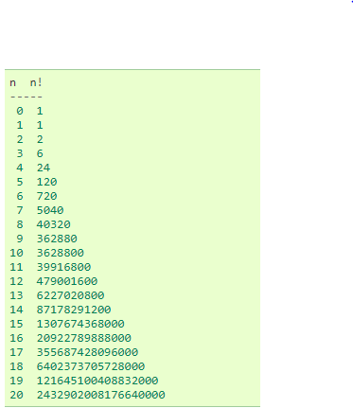

Slide 11
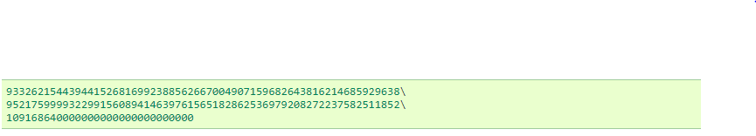
TSP continued…
As n get bigger, n! grows worse than exponentially. If you want to use brute-force to solve a 20-city problem, then you’ll need to generate 121645100408832000 different permutations, i.e. over 120 quintillion permutations. But that’s nothing compared to the 99! different permutations you would need to search through for a 100-city problem:
In practice, no matter how fast your computer, or how many you have, you won’t be able to generate this many permutations in a reasonable amount of time.
For large TSP problems even random guessing is terrible because it blindly takes permutations from a huge search space. It’s like searching for a needle in a giant haystack by randomly plucking out one straw at a time.

Slide 12
Brute-Force Strengths and Weaknesses
Strengths
wide applicability
simplicity
yields reasonable algorithms for some important problems (e.g., matrix multiplication, sorting, searching, string matching)
Weaknesses
rarely yields efficient algorithms
some brute-force algorithms are unacceptably slow
not as constructive as some other design techniques.
Brute force doesn’t work well for the TSP, but for some problems it is a good solution method. For example, perhaps you have heard of “alphametic”, or “cryptarithm” puzzles

Slide 13
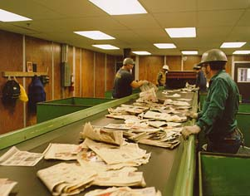
Sorting

Slide 14
The Sorting Problem
Input:
A sequence of n numbers a₁, a₂, . . . , a_{n}
Output:
A permutation (reordering) a₁’, a₂’, . . . , a_{n}’ of the input sequence such that a₁’ ≤ a₂’ ≤ · · · ≤ a_{n}’

Slide 15
Why Study Sorting Algorithms?
There are a variety of situations that we can encounter
Do we have randomly ordered keys?
Are all keys distinct?
How large is the set of keys to be ordered?
Need guaranteed performance?
Various algorithms are better suited to some of these situations

Slide 16
More Reasons to Sort
General technique in computing:
Preprocess the data to make subsequent operations (not just ADTs) faster
Example: Sort the data so that you can
Find the k^{th} largest in constant time for any k
Perform binary search to find elements in logarithmic time
Sorting's benefits depend on
How often the data will change
How much data there is

Slide 17
Real World versus Computer World
Sorting is a very general demand when dealing with data—we want it in some order
Alphabetical list of people
List of countries ordered by population
Moreover, we have all sorted in the real world
Some algorithms mimic these approaches
Others take advantage of computer abilities
Sorting Algorithms have different asymptotic and constant-factor trade-offs
No single “best” sort for all scenarios
Knowing “one way to sort” is not sufficient

Slide 18
Broad Classification in Sorting
Stable Sort: A sorting algorithm is said to be stable if the ordering of identical keys in the input is preserved in the output. E.g. Bubble Sort, Insertion Sort
In-place Sort: The amount of extra space required to sort the data is constant with the input size. Sorting of a data structure does not require any external data structure for storing the intermediate steps. E.g. Bubble Sort, Insertion sort etc.
Comparison sort: Only use comparisons to determine the relative order of elements. E.g. Insertion Sort, Merge sort etc.
Non-Comparison Sort: Redefining the concept of comparison to improve speed. E.g. Bucket Sort.
Internal Sort: The data to be stored is all stored in the computer’s main memory. E.g. Bubble Sort, Insertion sort etc.
External sort: Some of the data to be sorted might be stored in some external, slower, device. E.. external merge sort algorithm.

Slide 19
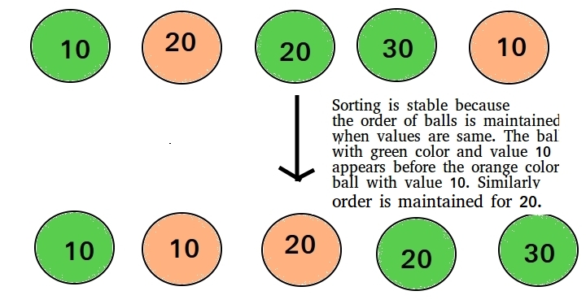
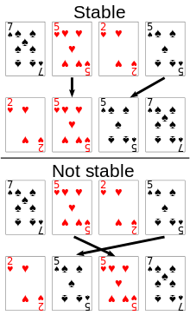
Stable Sorting

Slide 20
A Comparison Sort Algorithm
We have n comparable elements in an array, and we want to rearrange them to be in increasing order
Input:
An array A of data records
A key value in each data record (maybe many fields)
A comparison function (must be consistent and total): Given keys a and b is a<b, a=b, a>b?
Effect:
Reorganize the elements of A such that for any i and j such that if i < j then A[i] ≤ A[j]
Array A must have all the data it started with

Slide 21
Arrays? Just Arrays?
The algorithms we will talk about will assume that the data is an array
Arrays allow direct index referencing
Arrays are contiguous in memory
But data may come in a linked list
Some algorithms can be adjusted to work with linked lists but algorithm performance will likely change (at least in constant factors)
May be reasonable to do a O(n) copy to an array and then back to a linked list

Slide 22
Standard Comparison Sort Algorithms
Everyone and their mother's uncle's cousin's barber's daughter's friend has made a sorting algorithm

Slide 23
So Many Sorts
Sorting has been one of the most active topics of algorithm research:
What happens if we do … instead?
Can we eke out a slightly better constant time improvement?
Check these sites out on your own time:
http://en.wikipedia.org/wiki/Sorting_algorithm
http://www.sorting-algorithms.com/

Slide 24
Sorting: The Big Picture
Horrible algorithms:
Ω(n²)
Simple
algorithms:
O(n²)
Fancier
algorithms:
O(n log n)
Bogo Sort
Stooge Sort
Comparison
lower bound:
Ω(n log n)
Insertion sort
Selection sort
Bubble Sort
Shell sort
…
Specialized
algorithms:
O(n)
Heap sort
Merge sort
Quick sort (avg)
…
Bucket sort
Radix sort

Slide 25
Sorting: The Big Picture
Horrible algorithms:
Ω(n²)
Read about on your own to learn how not to sort data
Simple
algorithms:
O(n²)
Fancier
algorithms:
O(n log n)
Bogo Sort
Stooge Sort
Comparison
lower bound:
Ω(n log n)
Insertion sort
Selection sort
Bubble Sort
Shell sort
…
Specialized
algorithms:
O(n)
Heap sort
Merge sort
Quick sort (avg)
…
Bucket sort
Radix sort

Slide 26
Sorting: The Big Picture
Horrible algorithms:
Ω(n²)
Simple
algorithms:
O(n²)
Fancier
algorithms:
O(n log n)
Bogo Sort
Stooge Sort
Comparison
lower bound:
Ω(n log n)
Insertion sort
Selection sort
Bubble Sort
Shell sort
…
Specialized
algorithms:
O(n)
Heap sort
Merge sort
Quick sort (avg)
…
Bucket sort
Radix sort

Slide 27
Bogo sort
bogo sort: Orders a list of values by repetitively shuffling them and checking if they are sorted.
name comes from the word "bogus"
The algorithm:
Scan the list, seeing if it is sorted. If so, stop.
Else, shuffle the values in the list and repeat.
This sorting algorithm (obviously) has terrible performance!
What is its runtime?

Slide 28
Brute-Force Sorting Algorithms - Insertion Sort
To insert 12, we need to make room for it by moving first 36 and then 24.
6
10
24
36
12

Slide 29
Insertion Sort
6
10
24
36
12

Slide 30
Insertion Sort
6
10
24
36
12

Slide 31
Insertion Sort
input array
5 2 4 6 1 3
at each iteration, the array is divided in two sub-arrays:
left sub-array
right sub-array
sorted
unsorted

Slide 32
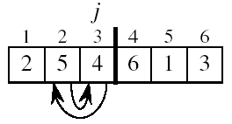
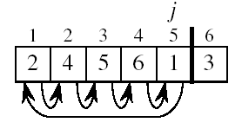
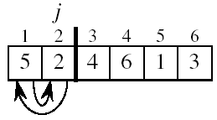
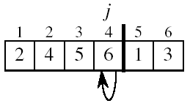
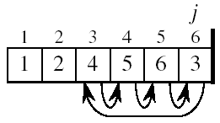
Insertion Sort

Slide 33
INSERTION-SORT
Alg.: INSERTION-SORT(A)
for j ← 2 to n
do key ← A[ j ]
Insert A[ j ] into the sorted sequence A[1 . . j -1]
i ← j - 1
while i > 0 and A[i] > key
do A[i + 1] ← A[i]
i ← i – 1
A[i + 1] ← key
Insertion sort – sorts the elements in place
1
2
3
4
5
6
7
8
a₁
a₂
a₃
a₄
a₅
a₆
a₇
a₈
key

Slide 34
Analysis of Insertion Sort
INSERTION-SORT(A)
for j ← 2 to n
do key ← A[ j ]
Insert A[ j ] into the sorted sequence A[1 . . j -1]
i ← j - 1
while i > 0 and A[i] > key
do A[i + 1] ← A[i]
i ← i – 1
A[i + 1] ← key
cost times
c₁ n
c₂ n-1
0 n-1
c₄ n-1
c₅
c₆
c₇
c₈ n-1
t_{j}: # of times the while statement is executed at iteration j
Notes:
₇

Slide 35
Best Case Analysis
The array is already sorted
A[i] ≤ key upon the first time the while loop test is run (when i = j -1)
t_{j} = 1
T(n) = c₁n + c₂(n -1) + c₄(n -1) + c₅(n -1) + c₈(n-1) = (c₁ + c₂ + c₄ + c₅ + c₈)n + (c₂ + c₄ + c₅ + c₈)
= an + b = Θ(n)
“while i > 0 and A[i] > key”

Slide 36
Worst Case Analysis
The array is in reverse sorted order
Always A[i] > key in while loop test
Have to compare key with all elements to the left of the j-th position ⇒ compare with j-1 elements ⇒ t_{j} = j
a quadratic function of n
T(n) = Θ(n²) order of growth in n²
“while i > 0 and A[i] > key”
we have:
using

Slide 37
Comparisons and Exchanges in Insertion Sort
INSERTION-SORT(A)
for j ← 2 to n
do key ← A[ j ]
Insert A[ j ] into the sorted sequence A[1 . . j -1]
i ← j - 1
while i > 0 and A[i] > key
do A[i + 1] ← A[i]
i ← i – 1
A[i + 1] ← key
cost times
c₁ n
c₂ n-1
0 n-1
c₄ n-1
c₅
c₆
c₇
c₈ n-1
≈ n²/2 comparisons
≈ n²/2 exchanges

Slide 38
Selection Sort
Selection Sort Scan the array to find its smallest element and swap it with the first element. Then, starting with the second element, scan the elements to the right of it to find the smallest among them and swap it with the second elements. Generally, on pass i (0 ≤ i ≤ n-2), find the smallest element in A[i..n-1] and swap it with A[i]: A[0] ≤ . . . ≤ A[i-1] | A[i], . . . , A[min], . . ., A[n-1]
in their final positions
An example follows…

Slide 39
Selection sort example
Initial array:
After 1st, 2nd, and 3rd passes:
index | 0 | 1 | 2 | 3 | 4 | 5 | 6 | 7 | 8 | 9 | 10 | 11 | 12 | 13 | 14 | 15 | 16
value | 22 | 18 | 12 | -4 | 27 | 30 | 36 | 50 | 7 | 68 | 91 | 56 | 2 | 85 | 42 | 98 | 25
index | 0 | 1 | 2 | 3 | 4 | 5 | 6 | 7 | 8 | 9 | 10 | 11 | 12 | 13 | 14 | 15 | 16
value | -4 | 18 | 12 | 22 | 27 | 30 | 36 | 50 | 7 | 68 | 91 | 56 | 2 | 85 | 42 | 98 | 25
index | 0 | 1 | 2 | 3 | 4 | 5 | 6 | 7 | 8 | 9 | 10 | 11 | 12 | 13 | 14 | 15 | 16
value | -4 | 2 | 12 | 22 | 27 | 30 | 36 | 50 | 7 | 68 | 91 | 56 | 18 | 85 | 42 | 98 | 25
index | 0 | 1 | 2 | 3 | 4 | 5 | 6 | 7 | 8 | 9 | 10 | 11 | 12 | 13 | 14 | 15 | 16
value | -4 | 2 | 7 | 22 | 27 | 30 | 36 | 50 | 12 | 68 | 91 | 56 | 18 | 85 | 42 | 98 | 25

Slide 40
Selection Sort
Alg.: SELECTION-SORT(A)
n ← length[A]
for j ← 1 to n - 1
do smallest ← j
for i ← j + 1 to n
do if A[i] < A[smallest]
then smallest ← i
exchange A[j] ↔ A[smallest]

Slide 41
Analysis of Selection Sort
Alg.: SELECTION-SORT(A)
n ← length[A]
for j ← 1 to n - 1
do smallest ← j
for i ← j + 1 to n
do if A[i] < A[smallest]
then smallest ← i
exchange A[j] ↔ A[smallest]
cost times
c₁ 1
c₂ n
c₃ n-1
c₄
c₅
c₆
c₇ n-1
n²/2
comparisons
n
exchanges

Slide 42
Analysis of Selection Sort – contd…

Slide 43
Insertion Sort vs. Selection Sort
They are different algorithms
They solve the same problem
Have the same worst-case and average-case asymptotic complexity
Insertion-sort has better best-case complexity (when input is “mostly sorted”)
Other algorithms are more efficient for larger arrays that are not already almost sorted
Insertion sort works well with small arrays

Slide 44
We Will NOT Cover Bubble Sort
Bubble Sort is not a good algorithm
Poor asymptotic complexity: O(n²) average
Not efficient with respect to constant factors
If it is good at something, some other algorithm does the same or better
However, Bubble Sort is often taught about
Some people teach it just because it was taught to them
Fun article to read: Bubble Sort: An Archaeological Algorithmic Analysis, Owen Astrachan, SIGCSE 2003

Slide 45
Bubble Sort (For your reference… Recall from CSE1001!)
Idea:
Repeatedly pass through the array
Swaps adjacent elements that are out of order
Easier to implement, but slower than Insertion sort
i
1
2
3
n
8
4
6
9
2
3
1
j

Slide 46
Example
8
4
6
9
2
3
1
1
8
4
6
9
2
3
i = 1
j
i = 2
j
8
4
6
9
2
1
3
1
2
8
4
6
9
3
i = 1
j
i = 3
j
8
4
6
9
1
2
3
1
2
3
8
4
6
9
i = 1
j
i = 4
j
8
4
6
1
9
2
3
1
2
3
4
8
6
9
i = 1
j
i = 5
j
8
4
1
6
9
2
3
1
2
3
4
6
8
9
i = 1
j
i = 6
j
8
1
4
6
9
2
3
1
2
3
4
6
8
9
i = 1
j
i = 7
1
8
4
6
9
2
3
j
i = 1
j

Slide 47
Bubble Sort
Alg.: BUBBLESORT(A)
for i ← 1 to length[A]
do for j ← length[A] downto i + 1
do if A[j] < A[j -1]
then exchange A[j] ↔ A[j-1]
i
8
4
6
9
2
3
1
i = 1
j

Slide 48
Bubble-Sort Running Time
Alg.: BUBBLESORT(A)
for i ← 1 to length[A]
do for j ← length[A] downto i + 1
do if A[j] < A[j -1]
then exchange A[j] ↔ A[j-1]
c₁
c₂
Comparisons: ≈ n²/2
c₃
c₄
Exchanges: ≈ n²/2
T(n) =
c₁(n+1) +
c₂
c₃
c₄
= Θ(n) +
(c₂ + c₂ + c₄)
Thus,T(n) = Θ(n²)

Slide 49
Truth in CS Act
NOBODY EVER USES BUBBLE SORT
NOBODY
NOT EVER
BECAUSE IT IS EXTREMELY INEFFICIENT

Slide 50
Analysis of Some sorting
Name | Best | Average | Worst | Stable | In-place
Bubble sort | ? | ? | ? | ? | ?
Insertion sort | ? | ? | ? | ? | ?
Selection sort | ? | ? | ? | ? | ?

Slide 51
Analysis of Some sorting
Name | Best | Average | Worst | Stable | In-place
Bubble sort | Ω(n²) | Θ(n²) | O(n²) | Yes | Yes
Insertion sort | Ω(n) | Θ(n²) | O(n²) | Yes | Yes
Selection sort | Ω(n²) | Θ(n²) | O(n²) | No (how?) | Yes

Slide 52
To Look at….
Boolean Satisfiability Problem

Slide 53
Sorting – Discussion Questions
Data on elementary school students is stored sorted by the age of the student. In preparation for track and field day, you wish to sort the students by their heights. Which of the sorting methods discussed today would you use? Explain.
While running a computer program to sort student exam scores using selection sort, the power goes out. Fortunately, the program was designed so it saved the scores after each swap. Just from looking at the saved scores, what information, if any, can you learn about the exam scores?
Would anything change if bubble sort was used instead?

Slide 54
Last Slide on Sorting… for now…
Best way to sort?
It depends!

